Slide 1
EDM Final

Slide 2


Introduction
World Economy and Education
Education and Data Mining
Graduation Rate and Education Inequality

Slide 3
Data Selection
-Conventional structured data
-grades
-academic records
-attendance records
-etc
-unstructured data
-lesson plans
-teaching software
-learning games
-online courses
-etc

Slide 4
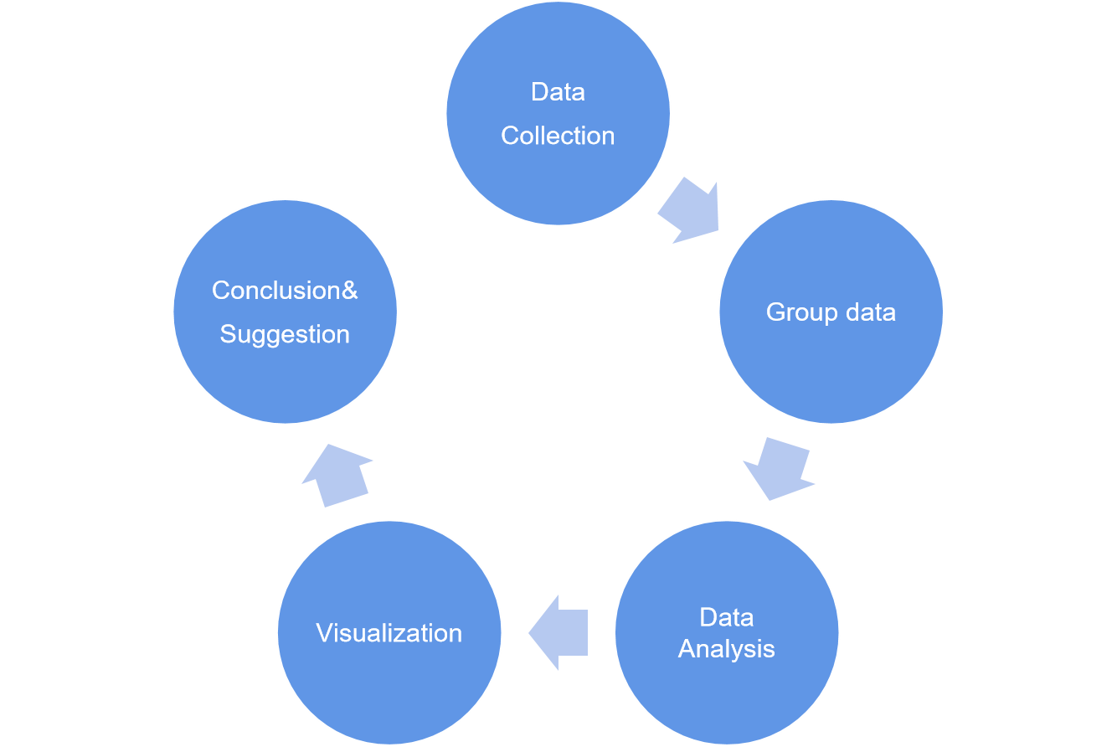
Data Manipulation

Slide 5
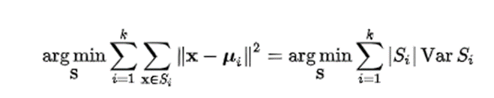
Method 1 - K mean clustering
Definitions:
Given a set of observations (x₁, x₂, ..., x_{n}), where each observation is a d-dimensional real vector, k-means clustering aims to partition the n observations into k (≤ n) sets S = {S₁, S₂, ..., S_{k}} so as to minimize the within-cluster sum of squares. Formally, the objective is to find:

Slide 6
How it works?
Find potential influential factors which could increase/decrease college graduation rates
Data clean - make a new table with those essential factors
Decide the number of K, it always starts from 1 and then performs iterative calculations until the positions of centroids are optimized with the nearest mean.
Report the optimal K-value and make a conclusion

Slide 7
Python
1. Pick ADM_RATE, SAT_AVG_All, CCBASIC, and CCSIZSET as four potential influencers, and then produce a new cleaned data set.
new_CollegeScorecardNA = new_CollegeScorecard.dropna()
CollegeClean = new_CollegeScorecardNA.drop(['id'], axis = 1)
2. K - means clustering, with k = 1,2,3,...etc
CollegekmeansK = KMeans(n_clusters=K)
CollegekmeansK.fit(CollegeClean)
cluster_motivationK = CollegekmeansK.predict(CollegeClean)
silhouetteScoreK = silhouette_score(CollegeClean, cluster_motivationK, metric='euclidean')
print('Silhouetter Score:', silhouetteScore3)
3. Report the optimized K according to the scores.
R Studio
1. Pick ADM_RATE, SAT_AVG_All, CCBASIC, and CCSIZSET as four potential influencers, and then produce a new cleaned data set.
new_CollegeScorecard <- select(CollegeScorecard, `UNITID`,`INSTNM`, `AD M_RATE` ,`SAT_AVG_ALL`,`CCBASIC`,`CCSIZSET`)
CollegeClean <- new_CollegeScorecard %>% na.omit() %>% select(-UNITID,-INSTNM)
2. K - means clustering, with k = 1,2,3,...etc
CollegeKCL <- kmeans(CollegeClean, centers = K)
disKCL = dist(CollegeClean)^2
silKCL = silhouette(CollegeKCL$cluster, disKCL)
fviz_silhouette(silKCL)
3. Report the optimized K according to the scores.

Slide 8
Model 2-Logic classification--- Naïve Bayes’ model
Definition:
Classification--- Naïve Bayes’ model
Bayes Theorem
---Independent
---Equal

Slide 9
Why use Naïve Bayes’ model?
They are extremely fast for both training and prediction
They provide straightforward probabilistic prediction
They are often very easily to be explained
They have very few (if any) tunable parameters

Slide 10
Formula
P(L | features)=
P(features | L)P(L)/
P(features)

Slide 11
Procedures
1. Grab data from each college and transfer the graduation rate into binary variables(for example, we set a value to classify the rate as high or low, let’s say 0.5, then the if the rate is greater than .5, we identify it as HIGH graduation rate; if it’s <.5, we say it’s LOW graduation rate)
2. Pick potential factors that may influence the graduation rate, such as crime rate, average SAT score, whether located in big city, and so on. Then do the binary transformation for those variables like step 1.
3. Import the Naive_Bayes package from Python or R, and train the model.
4. Perform the model by obtaining a predicted graduation rate(high or low), then compare the predicted outcome to the actual dataset.
5. Check the accuracy of each factor, pick those with relatively high accurate prediction to make further move(like applying for another prediction model)

Slide 12
Goals
Wipe out the low or non correlated elements to our target outcome(graduation rate)
So we don’t really care about the accurate ratio but just use them to do the identification(classification) for more complex correlation prediction.

Slide 13
Method 3:
PCA &
Logistic Regression
What is PCA?
PCA is a fast and flexible unsupervised method for dimensionality reduction in data; It tries to preserve the essential parts that have more variation of the data and remove the non-essential parts with fewer variation.
Why PCA?
To decrease the number of variables and make further analysis simpler.
What is Logistic Regression?
Logistic Regression is a classification algorithm that is used to predict the probability of a categorical dependent variable.
Why Logistic Regression?
fast and relatively uncomplicated
convenient to interpret the results
can be applied to multiclass problems

Slide 14
Method 3:
PCA &
Logistic Regression
Procedure
Preprocess data
Variables selection
Get rid of all missing values
Transfer categorical variables into continuous variables
Scale the data
Reduce the dimensionality of variables
Create and define your classification model
The logistic regression function 𝑝(𝐱) :
𝑝(𝐱) = 1 / (1 + exp(−𝑓(𝐱))
Predict variable:
y — whether a student would drop out from college? (binary: “1”, means “Yes”, “0” means “No”)
Model training: determining the coefficients 𝑏₀, 𝑏₁, …, 𝑏ᵣ that correspond to the best value of the cost function
Select the most appropriate model
Model Evaluation — Confusion Matrix

Slide 15
Conclusion

